Slide 1
DATA WAREHOUSING
By
Syed Bakhtawar Shah Abid
Assistant Professor
Department of Computer Science
Data Warehousing

Slide 2
Dimensional Modeling
Dimensional modeling gets its name from the business dimensions we need to incorporate into the logical data model.
It is a logical design technique to structure the business dimensions and the metrics that are analyzed along these dimensions.
Data Warehousing

Slide 3
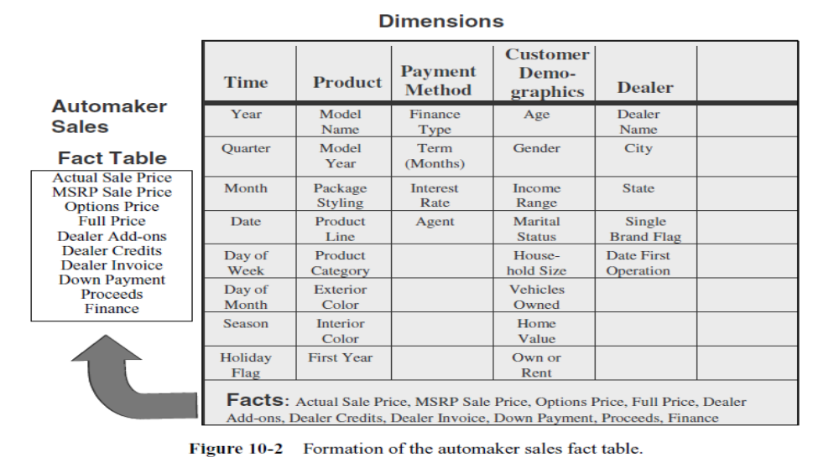
Dimensional Modeling
Data Warehousing

Slide 4
Dimensional Modeling
The following figure shows how the various dimension tables are formed from the information package diagram.
Look at the figure closely and see how each dimension table is formed.
Data Warehousing

Slide 5
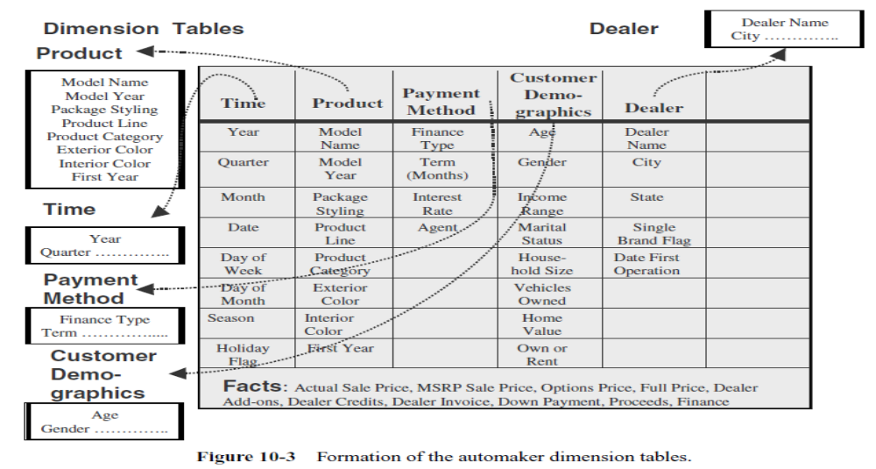
Dimensional Modeling
Data Warehousing

Slide 6
Dimensional Modeling
Here are some of the criteria for combining the tables in
  The model should provide the best data access.
  The whole model must be query-centric.
  It must be optimized for queries and analyses.
  The model must show that the dimension tables interact with the fact table.
  It should also be structured in such a way that every dimension can interact equally with the fact table.
  The model should allow drilling down or rolling up along dimension hierarchies.
Data Warehousing

Slide 7
Dimensional Modeling
With these requirements, we find that a dimensional model with the fact table in the middle and the dimension tables arranged around the fact table satisfies the conditions.
In this arrangement, each of the dimension tables has a direct relationship with the fact table in the middle.
Data Warehousing

Slide 8
Dimensional Modeling
This is necessary because every dimension table with its attributes must have an even chance of participating in a query to analyze the attributes in the fact table.
Such an arrangement in the dimensional model looks like a star formation, with the fact table at the core of the star and the dimension tables along the spikes of the star.
The dimensional model is therefore called a STAR schema
Data Warehousing

Slide 9
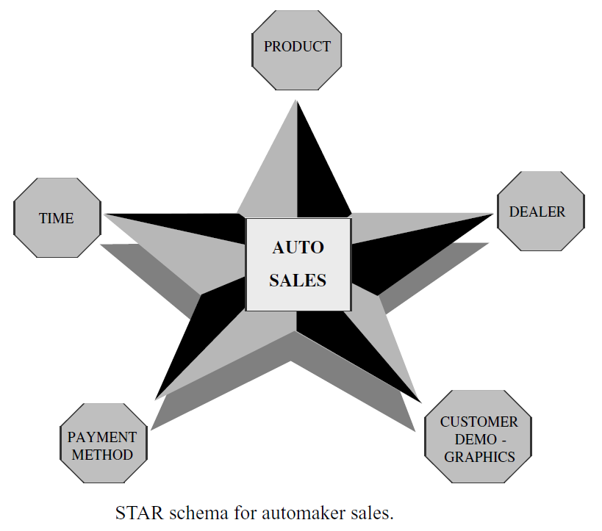
Dimensional Modeling
Data Warehousing

Slide 10
Why ER Modeling has been so successful?
Coupled with normalization drives out all the redundancy from the database.
Change (or add or delete) the data at just one point.
Resulted in success of OLTP systems.
Data Warehousing

Slide 11
Need for DM
ER and Normalization result in large number of tables which are:
  Hard to understand by the users
  Too complex for queries that span multiple tables with a large number of records
Data Warehousing

Slide 12
What is Dimensional Modeling?
Popularized by Ralph Kimball in the 1990s
A logical design technique that aims to present the data in a standard, intuitive form that allows for high-performance access
Dimensional modeling uses the concepts of Entity-Relationship (ER) modeling with some important restrictions
Essentially a “de-normalized” data model
Data Warehousing

Slide 13
What is Dimensional Modeling?
A simpler logical model optimized for decision support
Inherently dimensional in nature, with a single central fact table and a set of smaller dimensional tables
Composite key for the fact table
Dimensional tables with a single attribute key
Natural keys are replaced with surrogate keys, which allows the data in the warehouse to have some independence from the data used and produced by the OLTP system
Data Warehousing

Slide 14
Dimensional Modeling Schemas
Star schema is a logical structure that has a fact table containing factual data in the center, surrounded by dimension tables containing reference data (which can be denormalized). All relationships are mandatory M-1.
Snowflake schema is a variant of the star schema where dimension tables do not contain denormalized data.
Data Warehousing

Slide 15
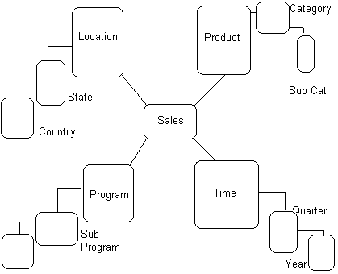
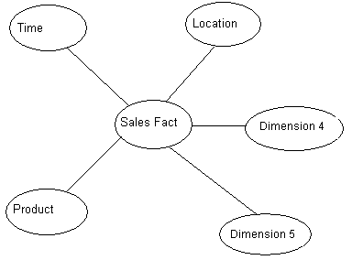
The two Schemas
Snow-Flake Schema Star schema
Data Warehousing

Slide 16
Fact Table
A fact table contains the actual business measures called facts
Also contain foreign keys for dimensions
keys
Sale
Time key
Store key
Customer key
Product key
Dollar sales
Unit sales
{
}
facts
Data Warehousing

Slide 17
Fact Table - example
Actual data might look like this
Granularity, or level of detail, is a key issue
Time-id | Store-id | Cust-id | Prod-id | Dollar sales | Unit Sales
T100 | S303 | C101 | P98 | $120,000 | 5,000
T101 | S303 | C256 | P98 | $240000 | 10,000
T102 | S387 | C101 | P10 | $456,000 | 27,899
T100 | S234 | C400 | P56 | $100,200 | 5,600
Data Warehousing

Slide 18
Dimension Tables
Customer
Customer key
Name
Customer type
Sale
Time key
Store key
Customer key
Product key
Dollar sales
Unit sales
Product
Product key
Product type
weight
Store
Store key
Address
Region
Time
Time key
Day
Month
Data Warehousing

Slide 19
Dimension Hierarchies
Product
Product key
Product type
Product group
Product sub-group
weight
Sale
Time key
Store key
Customer key
Product key
Dollar sales
Unit sales
Product group
- Product subgroup
- Product
Analysts tend to look at the data through dimension at a particular “level” in the hierarchy
Data Warehousing

Slide 20
Dimension Table - example
Actual data might look like this
Hierarchy evident in data
Prod-id | Prod-Name | Prod-Group | Prod-Subgroup | Weight
P10 | Hammer | Hardware | Tool | 5kg
P56 | 10cm Nails | Hardware | Nails | 1kg
P98 | Plastic Pipe | Plumbing | Pipe | 1kg
Data Warehousing

Slide 21
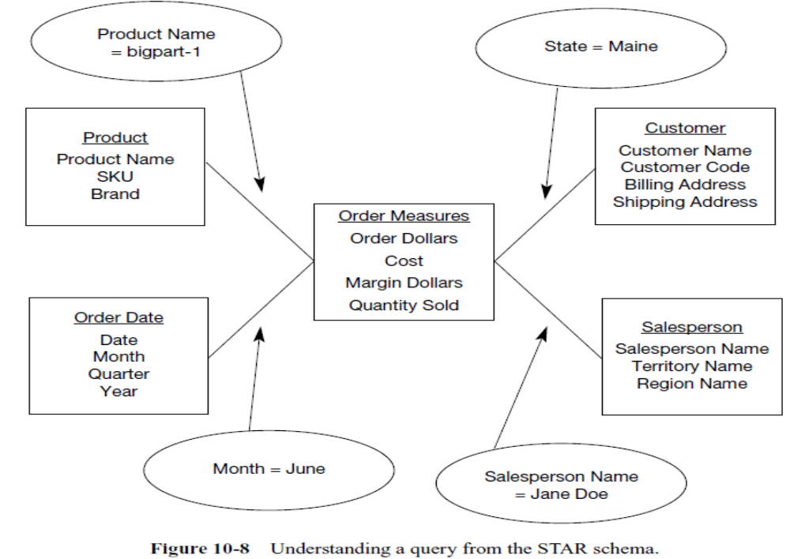
Understanding a Query from the Star Schema
Data Warehousing

Slide 22
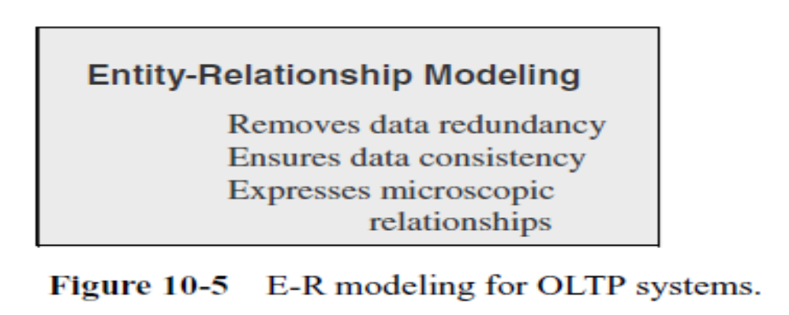
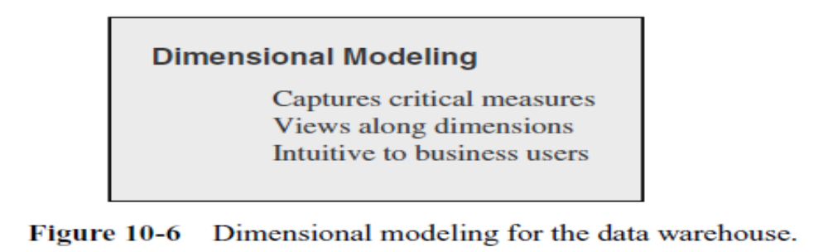
E-R Modeling Versus Dimensional Modeling
Data Warehousing

Slide 23
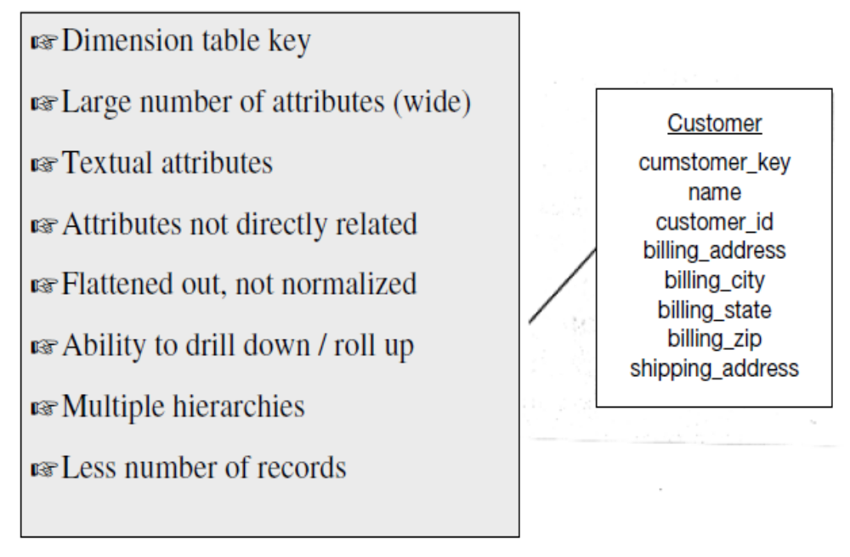
Inside a Dimension Table
Data Warehousing

Slide 24
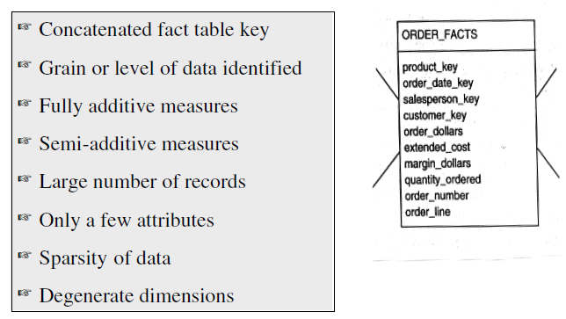
Inside a Fact Table
Data Warehousing

Slide 25
Inside a Fact Table
Data Grain
  The level of detail for the measurements or metrics
Fully Additive Measures
  Measures whose aggregation is done by simple addition
  In a certain query, let us say that the user wants the totals for the particular product on a certain date, not for a specific customer, but for customers in a particular state, then we need to find all the rows in the fact table relating to all the customers in that state and add the order_dollars, extended_cost, and quantity_ordered to come up with the totals.
Data Warehousing

Slide 26
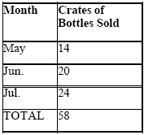
Fully-Additive facts
Fully Additive facts can be added across all dimensions and are easy to work with.
Summing the fact value gives meaningful results
Additive facts:
  Quantity sold
  Total Rs. Sales
Data Warehousing

Slide 27
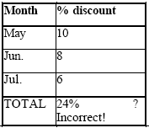
Non-Additive facts
Non-additive facts:
  A non additive fact is one which cannot be aggregated over any dimensions
  Percentages (% discount)
  Age
Data Warehousing

Slide 28
Semi-Additive facts
Semi-additive facts are facts that can be summed up for some of the dimensions in the fact table but not the others.
For example: Current_Balance is a semi-additive fact as it makes sense to add them up for all accounts (what's the total current balance for all accounts in the bank?) but it does not make sense to add them up through time (adding up all current balances for a given account for each day of the month does not give us any useful information
Data Warehousing

Slide 29
“Fact-less” Facts
“Fact-less” fact table
A fact table without numeric fact columns
Captures relationships between dimensions
Use a dummy fact column storing ‘Y’ or ‘N’ value. E.g., Attendance fact table of students
Data Warehousing

Slide 30
Inside a Fact Table
Sparse Data
  Fact table rows with null values
  E.g.
    No business on holidays so no entry on such particular dates
Data Warehousing

Slide 31
Inside a Fact Table
Degenerate Dimensions
  Look closely at the example of the fact table. You find the attributes of order_number and order_line.
  These are not measures or metrics or facts.
  These attributes are useful in some types of analyses.
  Attributes such as order_number and order_line in the example are called degenerate dimensions and these are kept as attributes of the fact table.
Data Warehousing

Slide 32
UPDATES TO THE DIMENSION TABLES
Compared to the fact table, the dimension tables are more stable and less volatile.
The fact table changes through the increase in the number of rows but a dimension table may change through changes to the attributes themselves
Changes in Dimension tables
  Slowly changing dimensions
  Rapidly changing dimensions
Data Warehousing

Slide 33
Explanation of Slowly
Changing Dimensions…
Although these dimensions change but the
change is not rapid.
Therefore called “Slowly” Changing
Dimensions
Data Warehousing

Slide 34
Explanation of Slowly Changing
Dimensions…
Most dimensions are generally constant over time
Compared to fact tables, contents of dimension tables are relatively stable
  New sales transactions occur constantly
  New products are introduced rarely
  New stores are opened very rarely
  Customers get married and divorced, have children, change addresses etc.
  Customer’s status changes from rental home to own home
Data Warehousing

Slide 35
Explanation of Slowly Changing
Dimensions…
The product key of the source record does not change
The description and other attributes change slowly over time
In the source OLTP systems, the new values overwrite the old ones
Overwriting of dimension table attributes is not always the appropriate option in a data warehouse. Rather there is a need to track changes
Dilemma: Want to track both old and new descriptions,
what should we do with the key?
where should we put the two values of the changed attribute?
Data Warehousing

Slide 36
Handling Slowly Changing
Dimensions
Types of changes in the dimension tables
Type 1 Changes (Correction of Errors)
Type 2 Changes (Preservation of History)
Type 3 Changes (Tentative Soft Revisions)
Data Warehousing

Slide 37
Type 1 Changes
(Correction of Errors)
Nature of Type 1 Changes
Usually, these changes relate to correction of errors in source systems
The old value in the source system needs to be discarded
The change in the source system need not be preserved in the data warehouse
Example: Customer’s name, product entered incorrectly
Data Warehousing

Slide 38
Type 1 Changes
(Correction of Errors)
Applying Type 1 Changes to the Data Warehouse
Overwrite the attribute value in the dimension table row with the new value
The old value of the attribute is not preserved
No other changes are made in the dimension table row
The key of the affected row or any other key values are not changed
This type is the easiest to implement
Data Warehousing

Slide 39
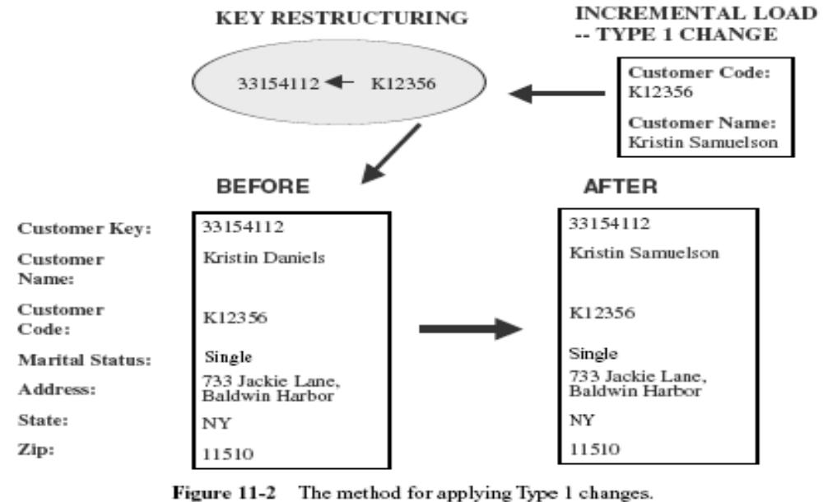
Type 1 Changes (Correction of Errors)
Data Warehousing

Slide 40
Type 2 Changes
(Preservation of History)
Nature of Type 2 Changes
They usually relate to true changes in source systems
There is a need to preserve the history in the data warehouse
This type of change partitions the history in the data warehouse
Every change for the same attribute must be preserved
Examples: A change in the marital status of a customer, moving to a new address
Data Warehousing

Slide 41
Type 2 Changes
(Preservation of History)
Applying Type 2 Changes to the Data Warehouse
Add a new dimension table row with the new value of the changed attribute
There are no changes to the original row in the dimension table
The key of the original row is not affected
The new row is inserted with a new surrogate key
Data Warehousing

Slide 42
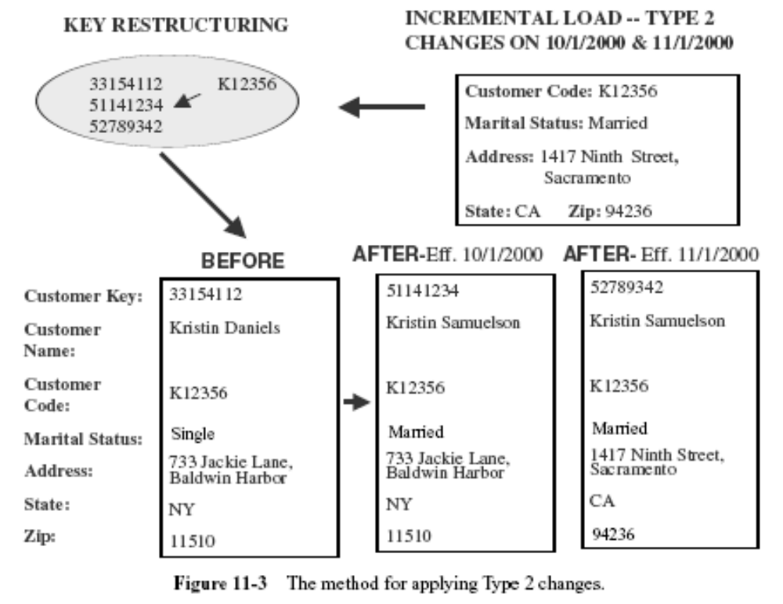
Type 2 Changes
(Preservation of History)
Data Warehousing

Slide 43
Type 3 Changes
(Tentative Soft Revisions)
Nature of Type 3 Changes
They usually relate to soft or tentative changes in the source systems
There is a need to keep track of history with old and new values of the changed attribute
Example: The name and organization of the sales regions change over time, and want to know how sales would have looked with old regions.
Data Warehousing

Slide 44
Type 3 Changes
(Tentative Soft Revisions)
Applying Type 3 Changes to the Data Warehouse
Add an old field in the dimension table for the affected attribute
Push down the existing value of the attribute from the current field to the old field
Keep the new value of the attribute in the current field
The surrogate key of the row is not affected
Only TWO most recent changes can be tracked
Data Warehousing

Slide 45
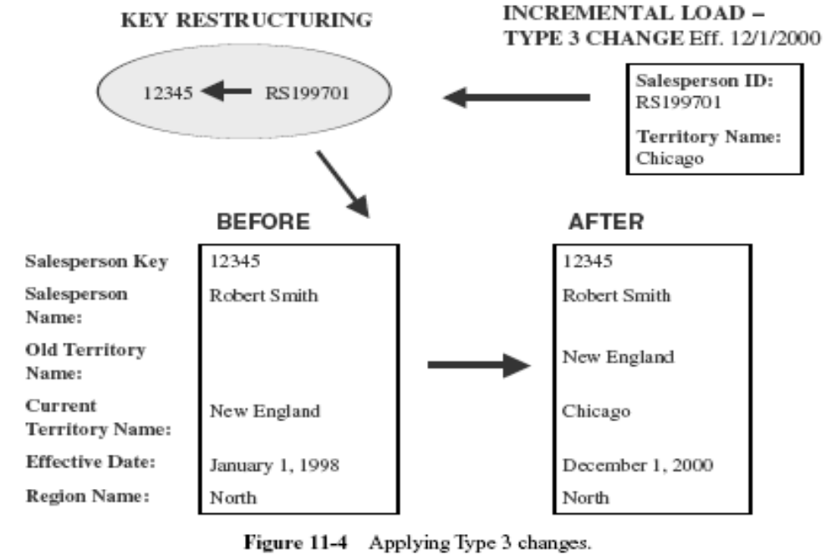
Type 3 Changes
(Tentative Soft Revisions)
Data Warehousing

Slide 46
Pros and Cons of Handling
Changes to Dimension Tables
Type-1: Overwrite existing value
+ Simple to implement
+ No tracking of history
Type-2: Add a new dimension row
+ Accurate historical reporting
+ Pre-computed aggregates unaffected
+ Dimension table grows over time
Type-3: Add a new field
+ Accurate historical reporting to last TWO changes
+ Record keys are unaffected
+ Dimension table size increases
Data Warehousing

Slide 47
Explanation of Rapidly
Changing Dimensions…
If changes in the dimension table are rapid e.g., the growing number of customers
Type-2 approach works well in many cases for the rapidly changing dimensions
However, if the dimension table is too large, some attributes change slowly and others rapidly then the dimension table needs to be split in two or more simpler dimensions
Data Warehousing

Slide 48
Step-4: Explanation of Rapidly
Changing Dimensions…
FACT Table
Customer Dimension
Customer Dimension (New)
Customer Key
Other Keys
…….
Metrics
Customer Key
Customer Name
Gender
DOB
Marital Status
Income Level
Credit Rating
Purchases Range
Life Style
Home Ownership
Customer Key
Customer Name
Gender
DOB
Marital Status
FACT Table
Customer Key
Behavior Key
Other Keys
…….
Metrics
Behavior Key
Income Level
Credit Rating
Purchases Range
Life Style
Home Ownership
Behavior
Dimension (New)
Data Warehousing

Slide 49
Fact Table Sizes
Telephone Call Monitoring
  Time Dimension: 5 years = 1825 days
  Number of calls tracked each day: 150 million
  Maximum number of base fact table records: 274 billion
Data Warehousing

Slide 50
Dimension Hierarchies
Hierarchy
Levels
Store
Hierarchy
Levels
Product
Store Key
Store Name
Territory
Region
Sales Facts
Product Key
Product
Category
Department
Product Key
Date Key
Store Key
Unit Sales
Sales Dollars
All Stores
All Products
Hierarchy
Levels
Time
Date Key
Date
Month
Quarter
Year
Data Warehousing

Slide 51
Aggregate Fact Tables
One-Way Aggregates
Two-Way Aggregates
Three-Way Aggregates
Data Warehousing

Slide 52
Aggregate Fact Tables
One-Way Aggregates
When you rise to higher levels in the hierarchy of one dimension and keep the level at the lowest in other dimensions. For example,
  Product category by store by date
  Product department by store by date
  Territory by product by date
  Region by product by date
  Month by store by product
Data Warehousing

Slide 53
Multi-Way Aggregate Fact Tables
Two-Way Aggregates
When you rise to higher levels in the hierarchies of two dimensions and keep the level at the lowest in other dimensions. For example,
  Category by territory by date
  Category by region by date
  Department by territory by date
  Department by month by store
  Territory by month by product
Data Warehousing

Slide 54
Multi-Way Aggregate Fact Tables
Three-Way Aggregates
When you rise to higher levels in the hierarchies of all the three dimensions. For example,
  Category by territory by month
  Category by region by month
  Department by territory by quarter
  Department by month by territory
  Territory by month by department
Data Warehousing

Slide 55
Multi-Way Aggregate Fact Tables
Each of these aggregate fact tables is derived from a single base fact table.
The derived aggregate fact tables are joined to one or more derived dimension tables.
Data Warehousing

Slide 56
Aggregate fact table and derived dimension table
Product
Store
Product Key
Product
Category
Department
Sales Fact
Base Table
Store Key
Store Name
Territory
Region
Product Key
Date Key
Store Key
Unit Sales
Dollar Sales
Time
Date Key
Date
Month
Quarter
Year
Category
Dimension derived from product
Sales Facts
One-Way Aggregate
Category Key
Category
Department
Category Key
Date Key
Store Key
Unit Sales
Dollar Sales
Data Warehousing

Slide 57
Advantage of Aggregation
Consider the example of the grocery store:
  Maximum number of base fact table records:
  1825 X 300 X 40,000 = 21,900,000,000 (22 billion)
Lets calculate the maximum number of rows in the one way aggregate --- Category totals by Store Name by Date
Category = 80, Store = 300, Date = 1825
Maximum number of aggregate fact table rows:
  43,800,000 (43 millions)
Data Warehousing

Slide 58
Aggregation Strategy
Industry Practices:
Each aggregate table row should summarize at least 10 rows in the lower level table. An increase to 20 rows or more is remarkable
Develop a list of attributes that are useful candidates for aggregation, then work out the combinations of these attributes to come up with your first set of multi-way aggregate fact tables.
Determine the derived dimension tables you need to support these aggregate fact tables
Data Warehousing

Slide 59
Case Study:
Amadeus Entertainment Dimensional Modeling (Rainardi)
Business Area: Product Sales
Data Mart: Order-Item
Event: Product Sale event happens when a customer buys a product
Roles (who, where, what):Customer, Store, Product
Levels (measures): Quantity, Unit_Price, Unit_Cost, Sales_Value, Sales_Cost, Margin
Data Warehousing

Slide 60
Case Study: Amadeus Entertainment Dimensional Modeling
Put measures (levels) in the fact table
Roles and dates in the dimension tables
An Event becomes a row of the fact table
Unit_Price, Qty, and Unit_Cost are derived from the source system but Sales_Value, Sales_Cost, and Margin are calculated as following:
  sales_value = unit_price x qty
  sales_cost = unit_cost x qty
  margin = sales_value – sales_cost
Data Warehousing

Slide 61
Case Study: Amadeus Entertainment Dimensional Modeling
Grain is the smallest unit of occurrence of the business event
Grain completes the sentence “one row in the fact table is ………”
Here, one row in the Product Sales fact table corresponds to each item sold
Data Warehousing

Slide 62
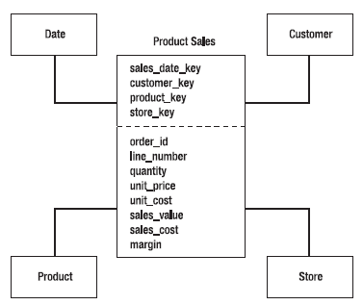
Product Sales Fact Table and Its Dimensions
Order-Item Data Mart
Data Warehousing

Slide 63
Data Mart
A Data Mart can have multiple fact tables
It is a group of related fact tables and their corresponding dimension tables containing measurements of business events categorized by dimensions.
Data Marts exist in dimensional data stores
Data Warehousing

Slide 64
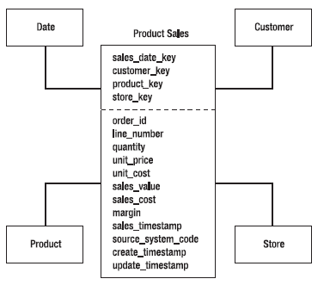
Product Sales Fact Table and Its Dimensions with Timestamp columns
Data Warehousing

Slide 65
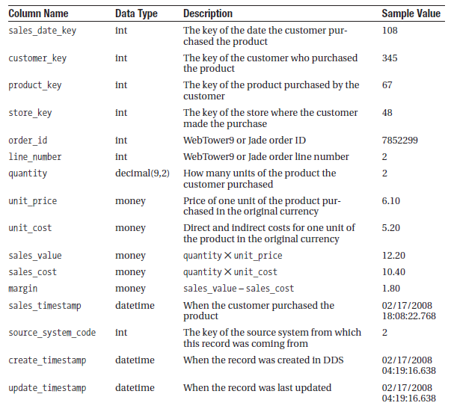
Product Sales Fact Table
Data Warehousing

Slide 66
Dimension Tables
Referential Integrity (Parent Child Relationship)
  Hard RI (Maintained by a DBMS constraint)
  Soft RI (Maintained by ETL)
Data Warehousing

Slide 67
Date Dimension
Almost every data mart has this dimension
Date vs. Time Dimension
  10 years data we have 3650 rows for date dimension
  315 million rows with time dimension having precision to the second
  Use timestamp in the fact table storing the time of event happened (99% cases)
  Time of day dimension (1% case)
  Time of day dimension is used when different periods of a day have different meanings e.g., ‘happy hour’, ‘night shift’, ‘off peak’ otherwise timestamp in fact table is used for better performance
Data Warehousing

Slide 68
Date Dimension
Attributes can be categorized into 4 groups
  Date formats attributes, storing dates in various formats
  Calendar date attributes, storing various elements of a date e.g., day, month, quarter, year
  Fiscal attributes, storing elements of fiscal calendar e.g., fiscal week, fiscal period, fiscal year
  Indicator attributes, storing a Boolean value indicating whether a particular date satisfies a condition e.g., is it a national holiday?
Data Warehousing

Slide 69
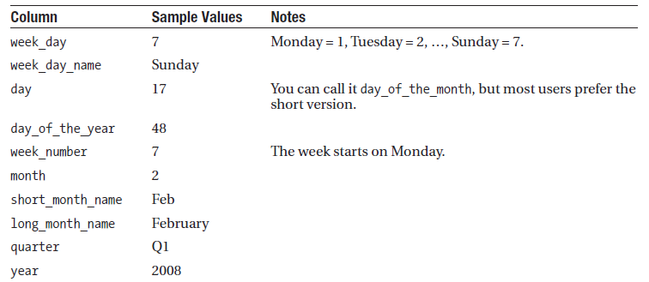
Calendar Date Attributes for February 17, 2008
Data Warehousing

Slide 70
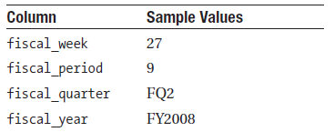
Fiscal Calendar Attributes for February 17, 2008
Assuming Fiscal year starts on September 1 and there are 12 fiscal periods in a year with four or five weeks each:
Data Warehousing

Slide 71
Indicator Attributes
week_day, 1 from Monday to Friday otherwise 0
national_holiday, 1 if it is a holiday. Can keep several columns if operate in several countires
last_day_in_month, 1 if last day of the month otherwise 0
period_end, 1 if it is last day of fiscal period otherwise 0
Data Warehousing

Slide 72
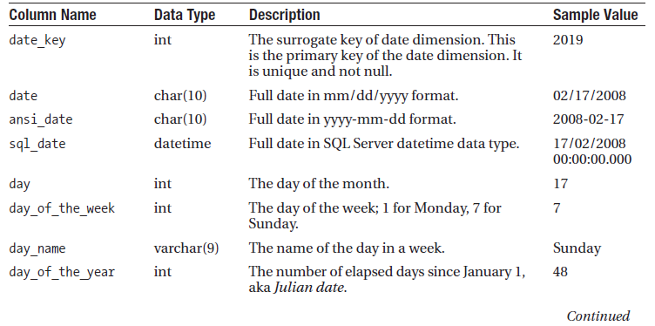
Sample Date Dimension
Data Warehousing

Slide 73
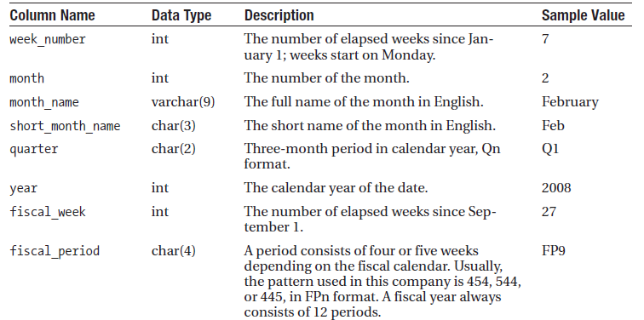
Sample Date Dimension
Data Warehousing

Slide 74
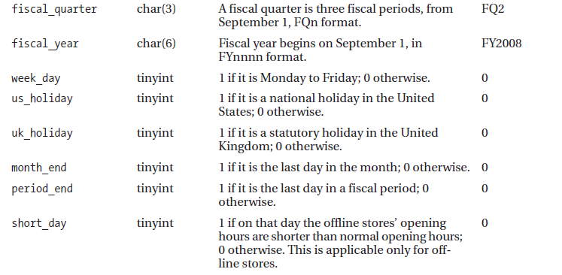
Sample Date Dimension
Data Warehousing

Slide 75
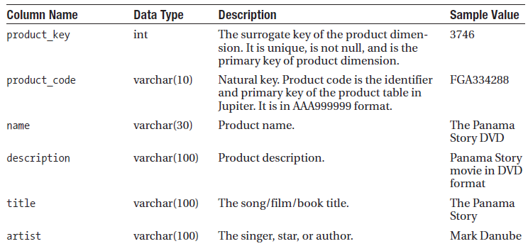
Product Dimension
Data Warehousing

Slide 76
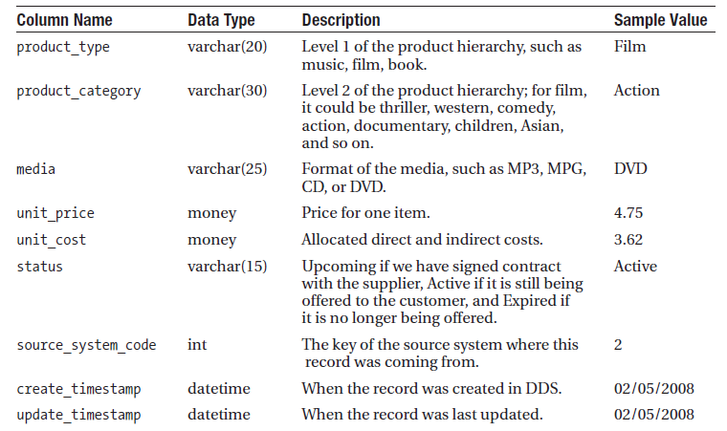
Product Dimension
Data Warehousing

Slide 77
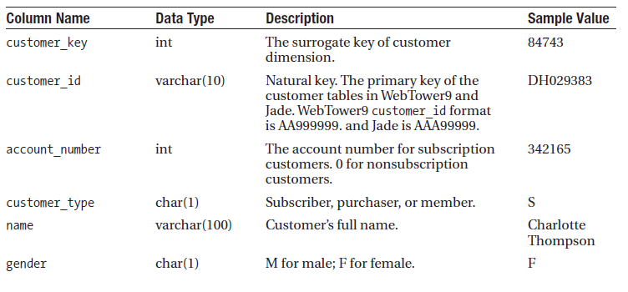
Customer Dimension
Data Warehousing

Slide 78
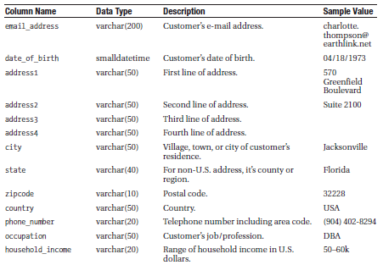
Customer Dimension
Data Warehousing

Slide 79
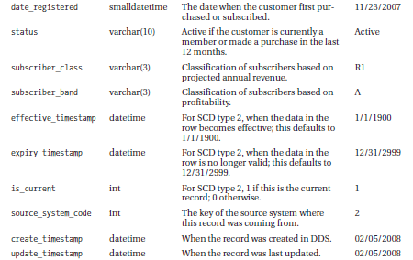
Customer Dimension
Data Warehousing

Slide 80
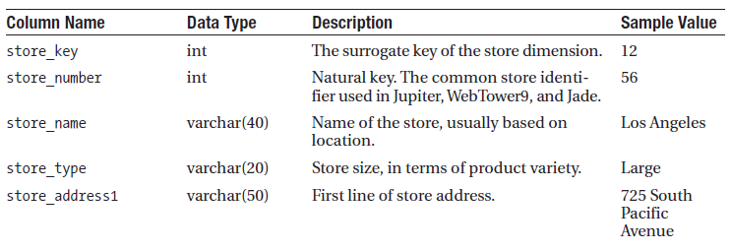
Store Dimension
Data Warehousing

Slide 81
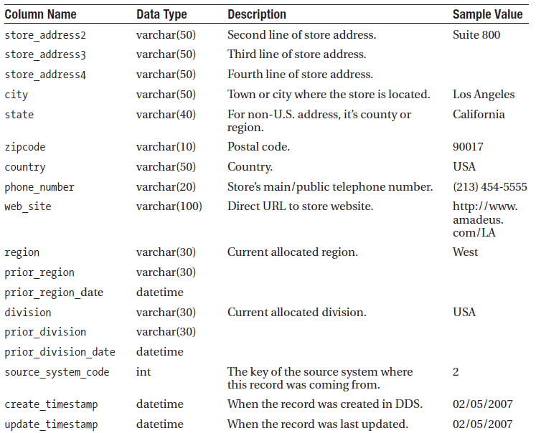
Store Dimension
Data Warehousing

